Slide 1
Time Series Analysis PACF, ARMA and ARIMA models
Dr. Babji Srinivasan
Department of Applied Mechanics
IIT Madras

Slide 2
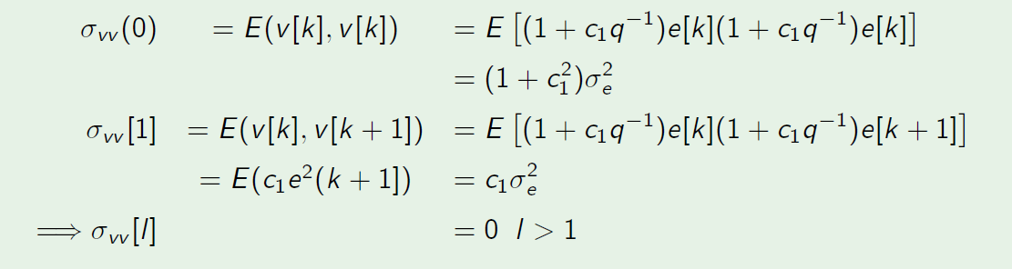
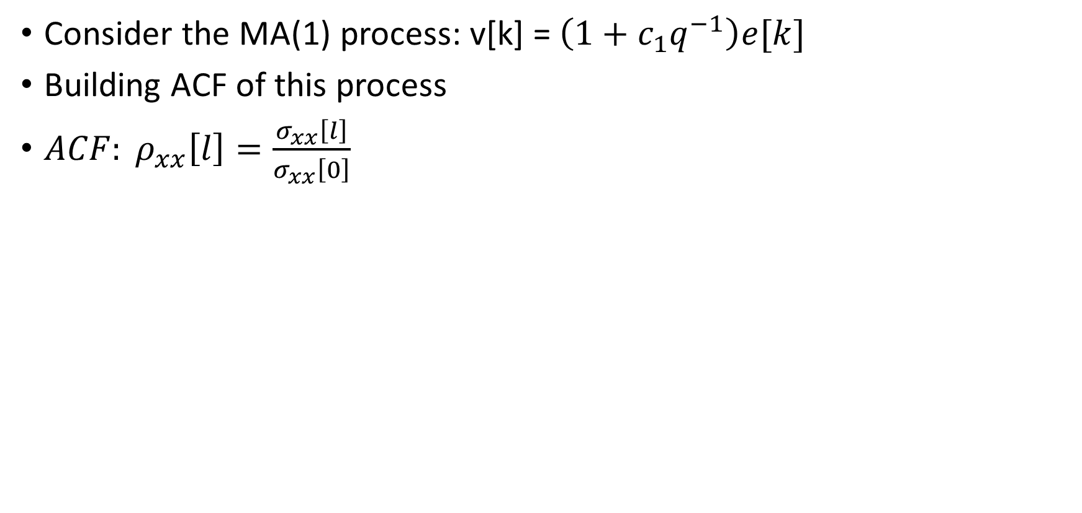
Estimating the order of an MA(p) process Example:
Consider the MA(1) process: v[k] = $\left(1+c_{1}q^{−1}\right)e[k]$
Building ACF of this process
${ACF: ρ}_{xx}\left[l\right]=\frac{σ_{xx}\left[l\right]}{σ_{xx}\left[0\right]}$

Slide 3
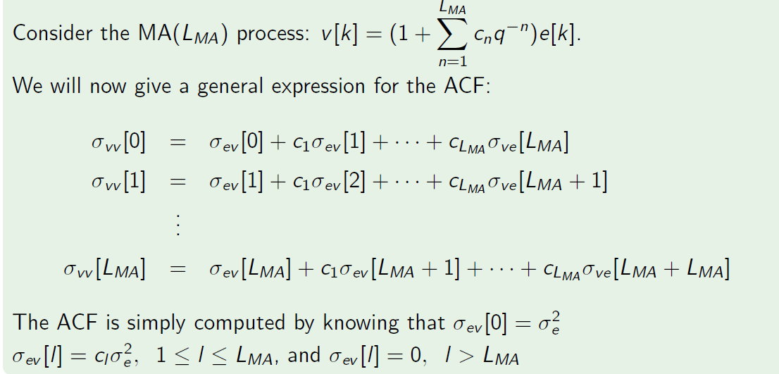
Estimating the order of an MA(p) process

Slide 4
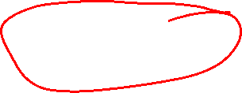
Partial ACF
We learnt earlier that correlation-based measures suffer from confounding, i.e., the common influence of a third extraneous variable can cause two variables to appear as correlated.
The correlation between two observations of a series (or two different series) is most likely to suffer from confounding because the intermediate samples can introduce an apparent correlation due to propagated effects. While this phenomenon holds for any random process, it becomes particularly important for auto-regressive processes.
We understand the issue of confounding in ACF by revisiting the ACF of an AR(1) process.

Slide 5
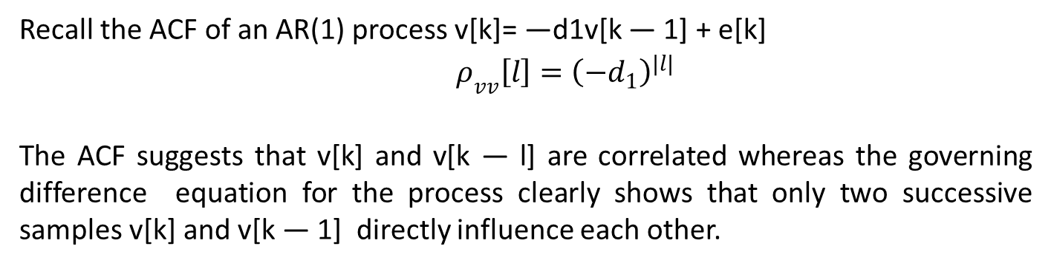
ACF of an AR(1) process
Recall the ACF of an AR(1) process v[k]= —d1v[k — 1] + e[k]
$ρ_{vv}\left[l\right]={\left(−d_{1}\right)}^{|l|}$
The ACF suggests that v[k] and v[k — l] are correlated whereas the governing difference equation for the process clearly shows that only two successive samples v[k] and v[k — 1] directly influence each other.

Slide 6
ACF of an AR(1) process
Q: What is the cause of this apparent correlation between samples separated by las
L > 1?
A: The cause for this apparent correlation is the propagated effect. For instance, the
difference equation of the process can be re-written as:
Thus v[k − 2] appears to influence v[k] indirectly through v[k − 1]. The same
argument can be extended to explain correlation at other lags as well.
How do we ensure ACF measures direct correlations only?

Slide 7
Conditioned ACF: Partial ACF
To measure the direct correlation between v[k − l] and v[k] we should account for the
possible propagated effects of the intermediate variables {v[k − l + 1, · · · , v[k − 1]}.
The procedure is illustrated for l = 2. The idea is to remove the presence of v[k − 1] in
both v[k] and v[k − 2] followed by a correlation between the respective residuals. The
resulting correlation is known as partial auto-correlation function (PACF)

Slide 8
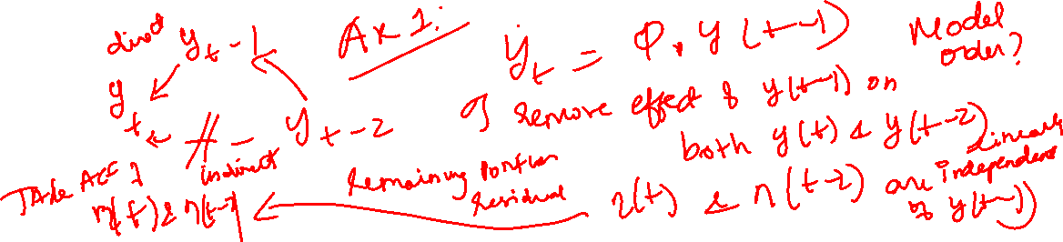
Partial ACF
Partial ACF is analogous to “partial derivative” where only the effects w.r.t. a
specific variable are evaluated.
As we learnt earlier, computing partial correlation (or any other measure) is known
as conditioning in signal processing
The partial ACF measures direct correlation whereas the ACF measures total
correlation

Slide 9
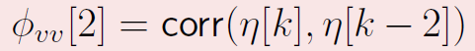
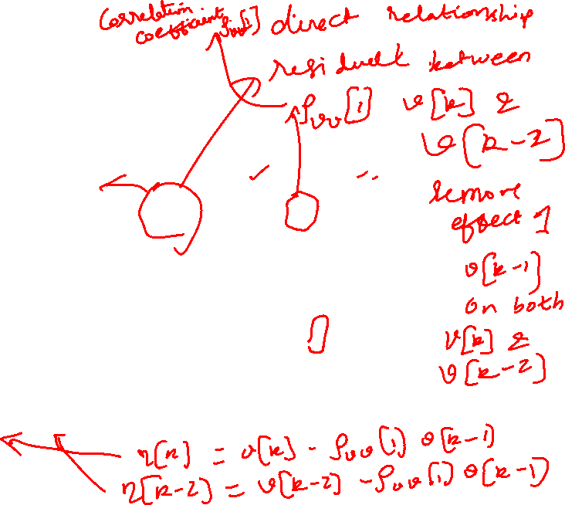
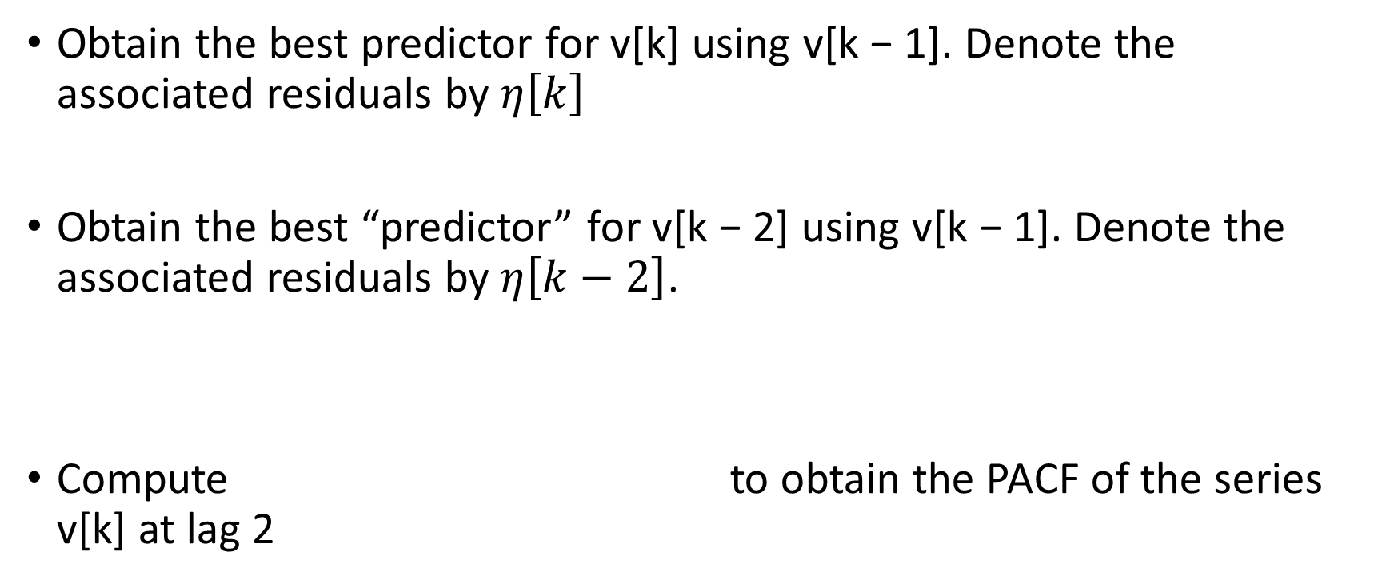
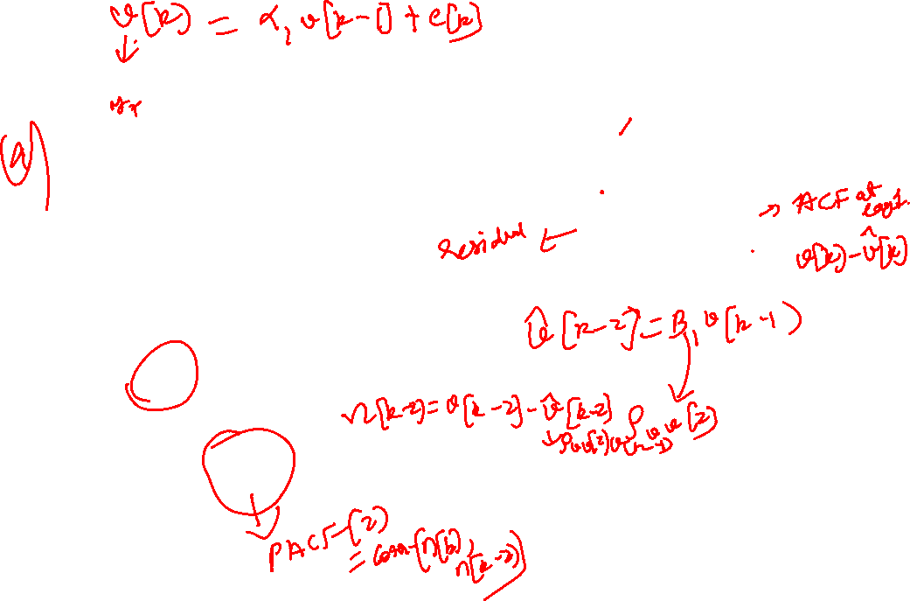
Procedure to compute PACF
Obtain the best predictor for v[k] using v[k − 1]. Denote the associated residuals by $η\left[k\right]$
Obtain the best “predictor” for v[k − 2] using v[k − 1]. Denote the associated residuals by $η\left[k−2\right]$.
Compute to obtain the PACF of the series v[k] at lag 2

Slide 10
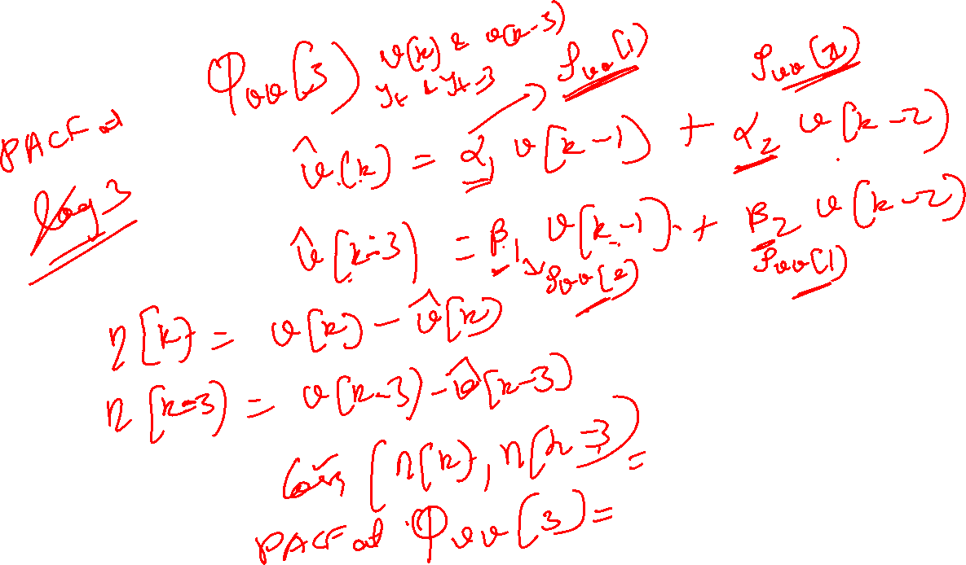

Slide 11
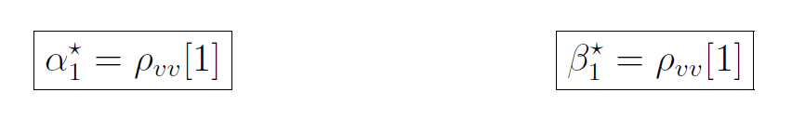
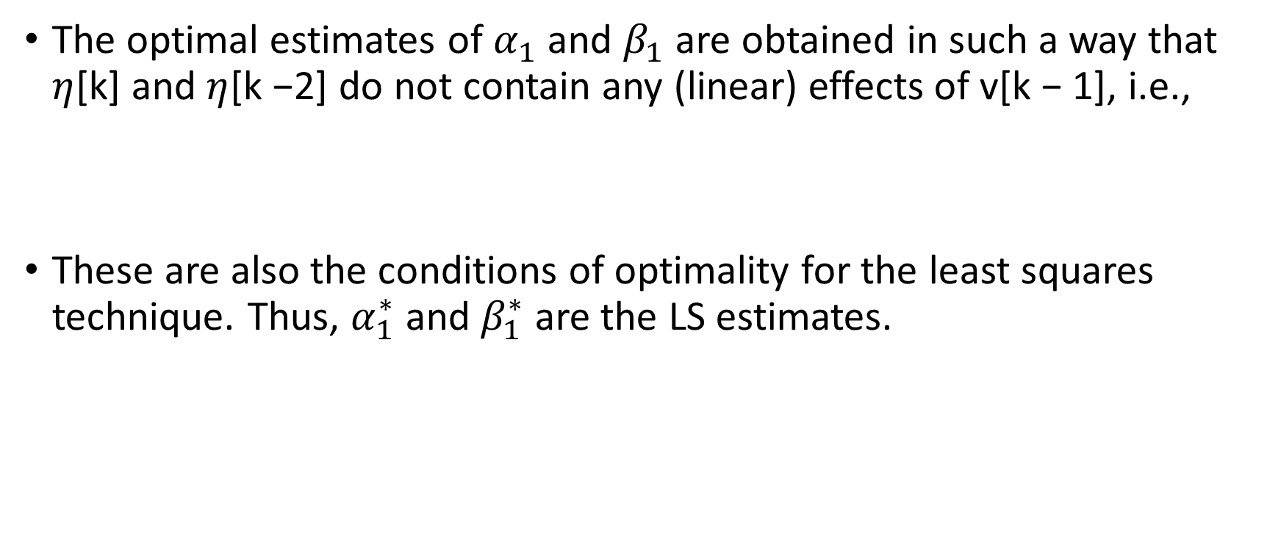
Procedure to compute PACF . . . contd.
The optimal estimates of $α_{1}$ and $β_{1}$ are obtained in such a way that $η$[k] and $η$[k −2] do not contain any (linear) effects of v[k − 1], i.e.,
These are also the conditions of optimality for the least squares technique. Thus, $α_{1}^{∗}$ and $β_{1}^{∗}$ are the LS estimates.

Slide 12
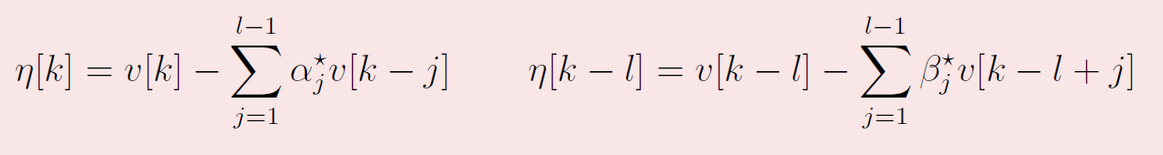
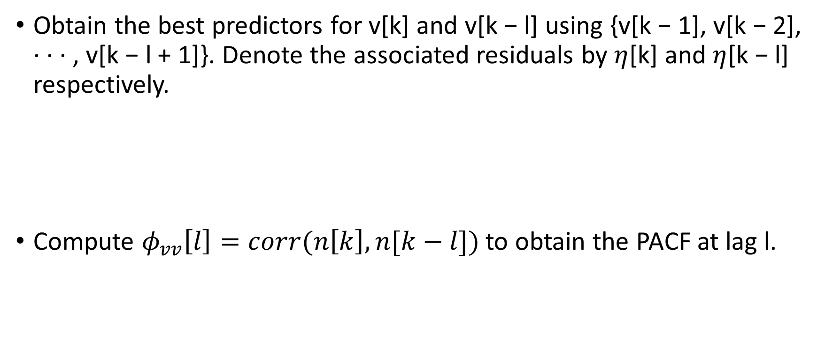
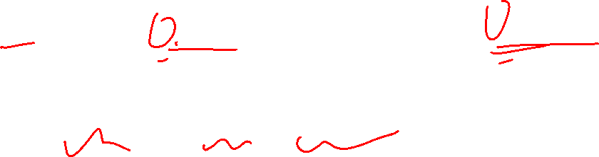
General procedure
Obtain the best predictors for v[k] and v[k − l] using {v[k − 1], v[k − 2], · · · , v[k − l + 1]}. Denote the associated residuals by $η$[k] and $η$[k − l] respectively.
Compute $φ_{vv}\left[l\right]=corr(n\left[k\right], n[k−l])$ to obtain the PACF at lag l.

Slide 13
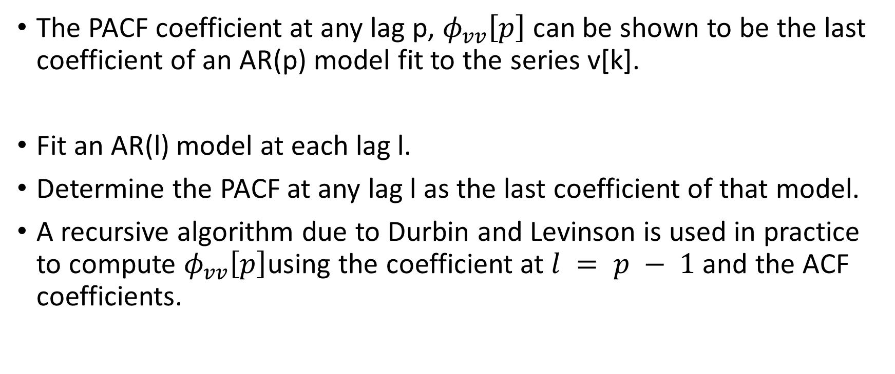
Alternative procedure
The PACF coefficient at any lag p, $φ_{vv}\left[p\right]$ can be shown to be the last coefficient of an AR(p) model fit to the series v[k].
Fit an AR(l) model at each lag l.
Determine the PACF at any lag l as the last coefficient of that model.
A recursive algorithm due to Durbin and Levinson is used in practice to compute $φ_{vv}\left[p\right]$using the coefficient at $l = p − 1$and the ACF coefficients.

Slide 14
Remarks
The “prediction” of v[k - l] using future values is known as backcasting
The PACF at lag l =0 is not defined. However, to be consistent with ACF, PACF at lag l =0 maybe set to unity.

Slide 15
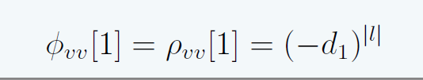
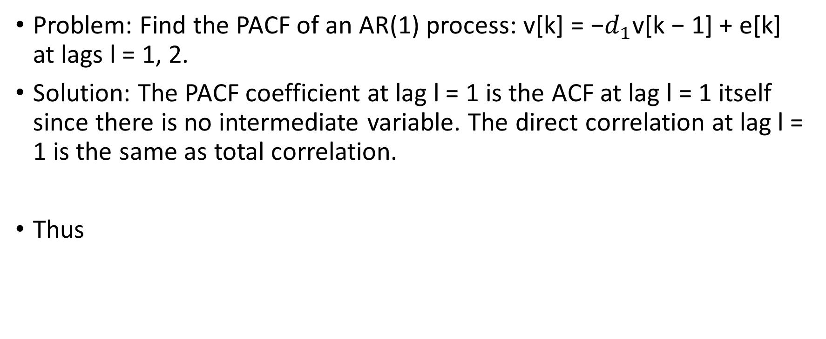
PACF of an AR(1) process
Problem: Find the PACF of an AR(1) process: v[k] = −$d_{1}$v[k − 1] + e[k] at lags l = 1, 2.
Solution: The PACF coefficient at lag l = 1 is the ACF at lag l = 1 itself since there is no intermediate variable. The direct correlation at lag l = 1 is the same as total correlation.
Thus

Slide 16
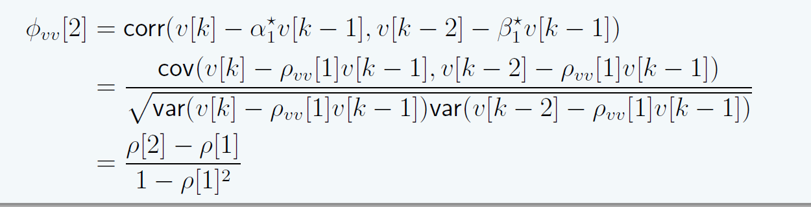
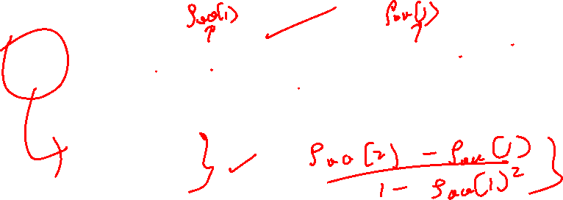
PACF of an AR(1) process
To compute the PACF at lag l = 2, recall from the procedure

Slide 17
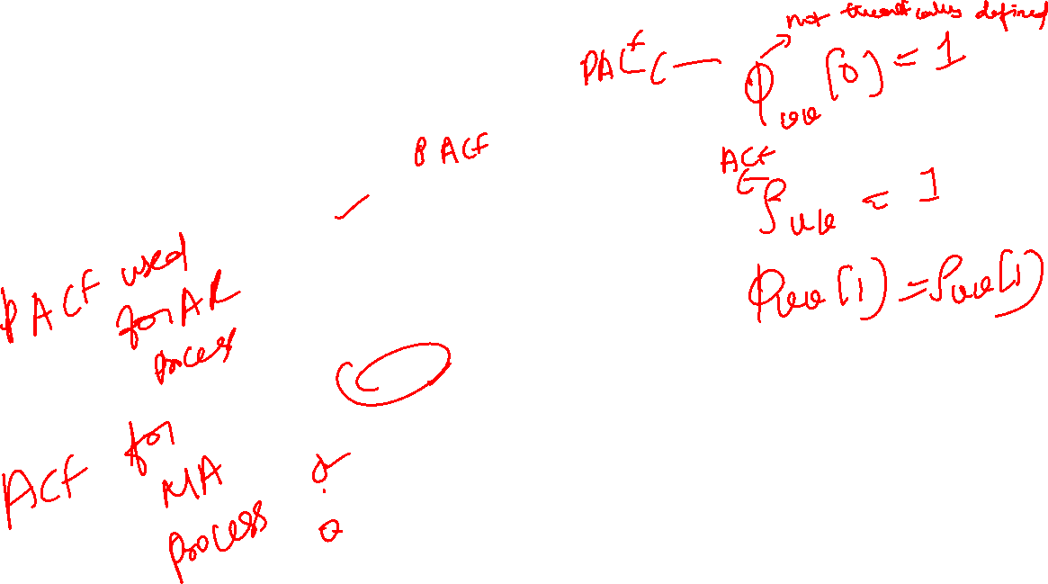
Theoretical PACF: Examples
White Noise process
AR(1) process
PACF
0.4 0.8
0.8
PACF
0.4
0.0
0.0
0
5 10 15
Lags
20
0
5 10 15 20
Lags
MA(1) process
AR(2) process
0.8
0.8
PACF
0.0 0.4
PACF
0.4
0.0
0
5 10 15
Lags
20
0
5 10 15 20
Lags

Slide 18
Remarks
The PACF of a WN process is zero at all lags (like the ACF)
PACF of an MA(1) process dies down exponentially (somewhat analogous to the behaviour of ACF for an AR(1) process).
The notion of PACF can be extended to handle negative lags as well. For stationary processes, PACF is symmetric like the ACF

Slide 19
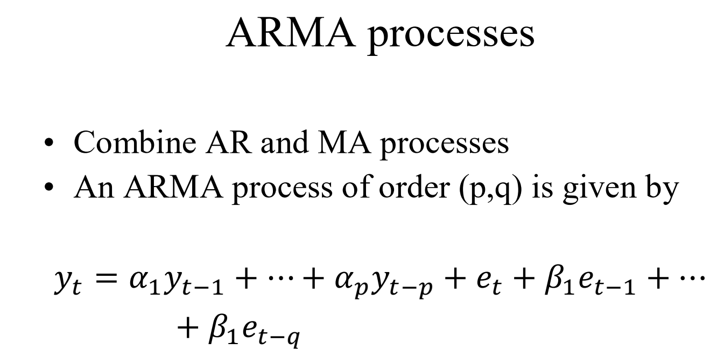

Slide 20
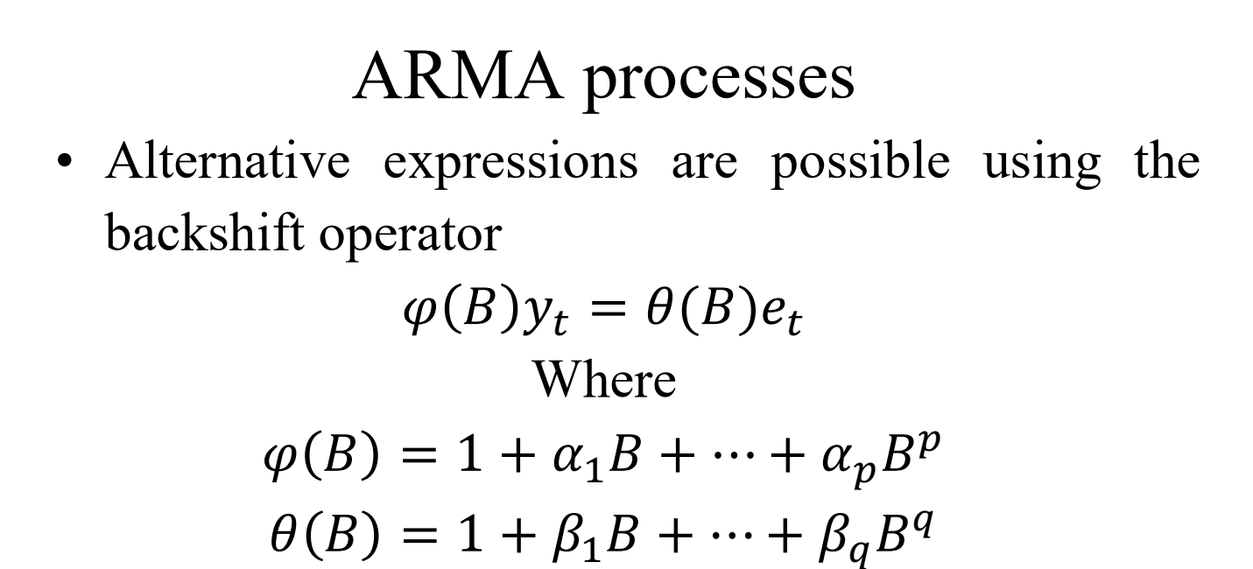

Slide 21
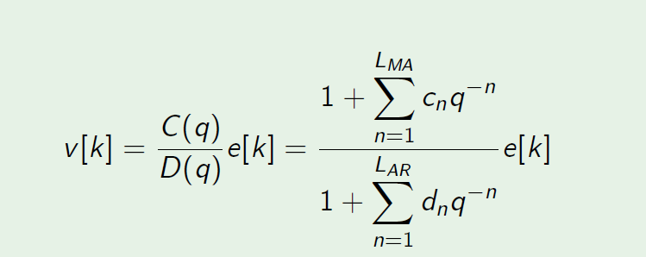

ARMA processes
A random process that contains both auto-regressive and moving average parts is said to be an ARMA(L_{AR}, L_{MA}) process.

Slide 22
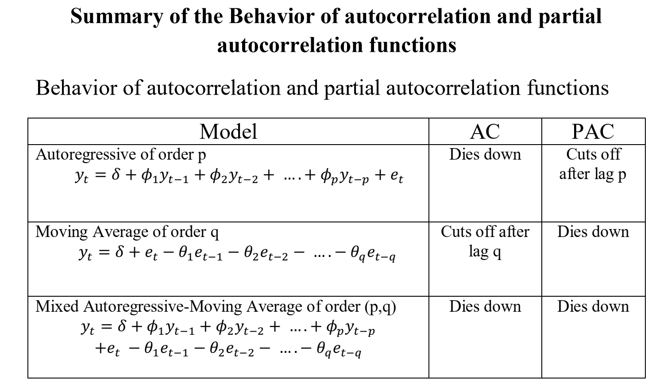

Slide 23
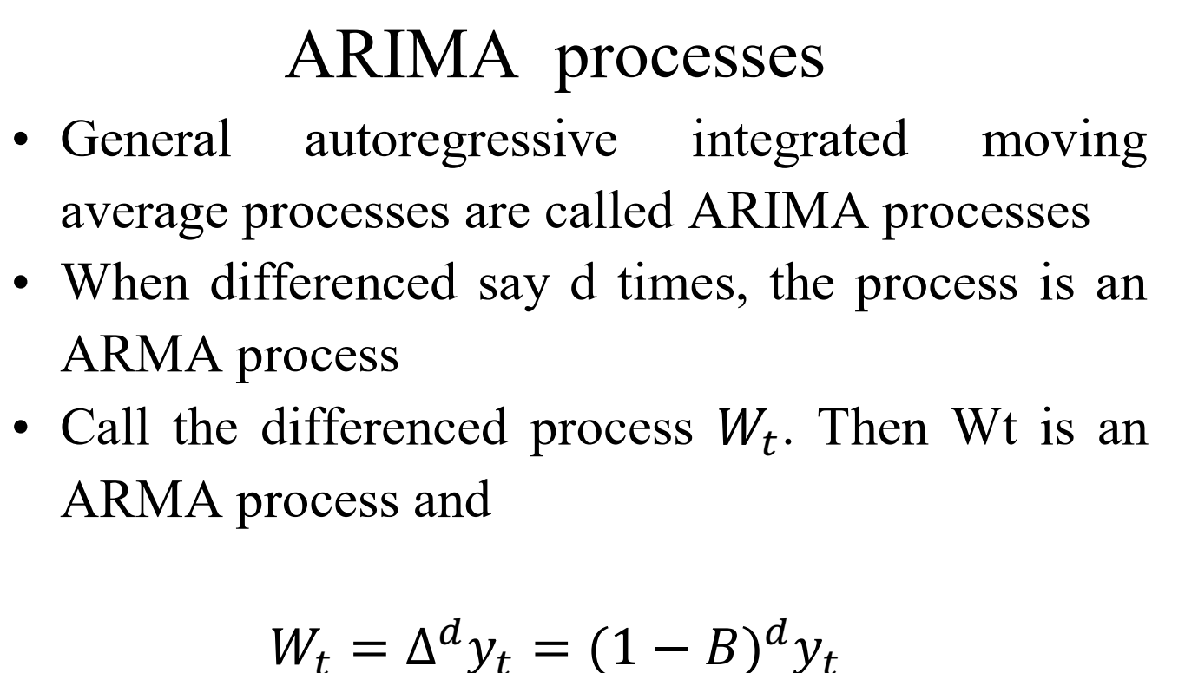
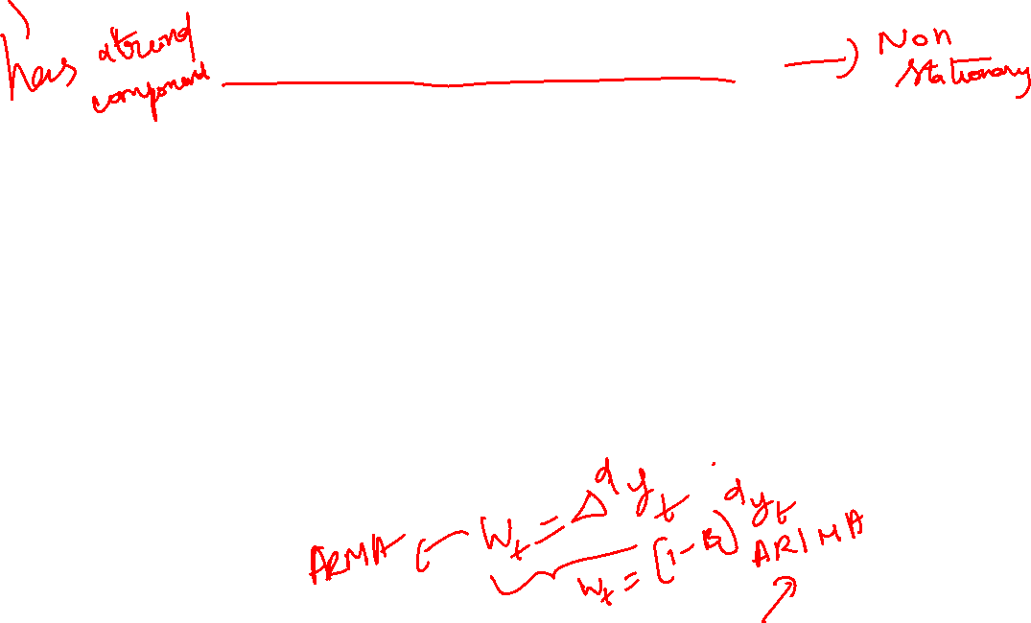

Slide 24
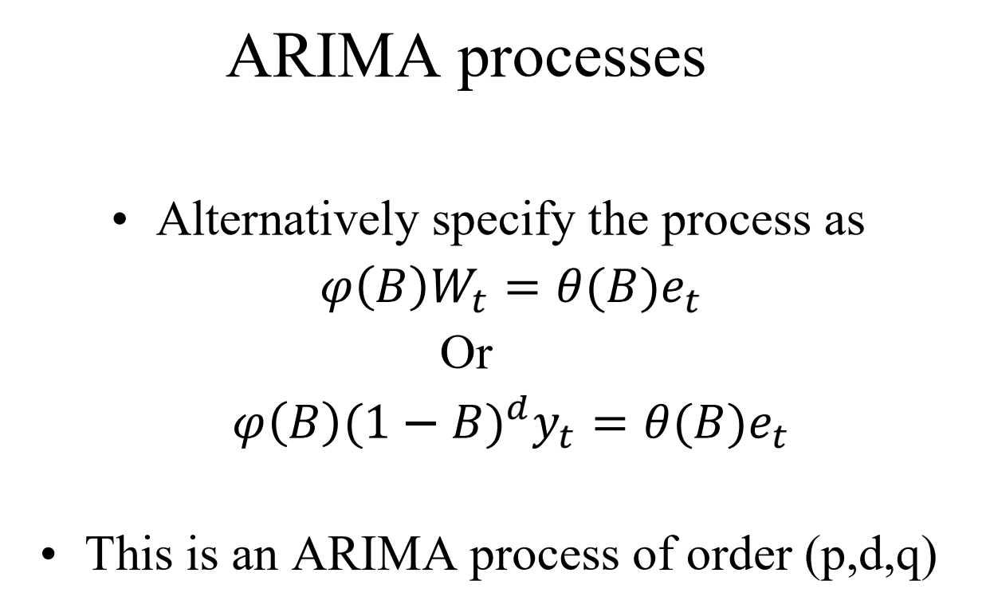
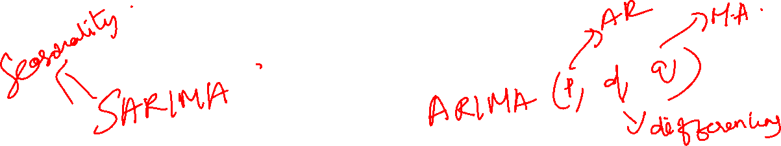

Slide 25
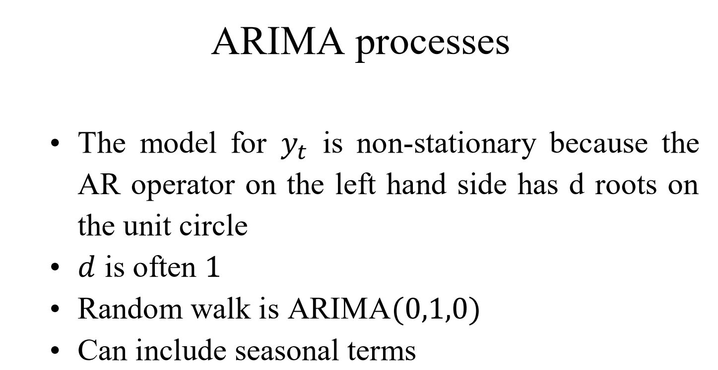

Slide 26
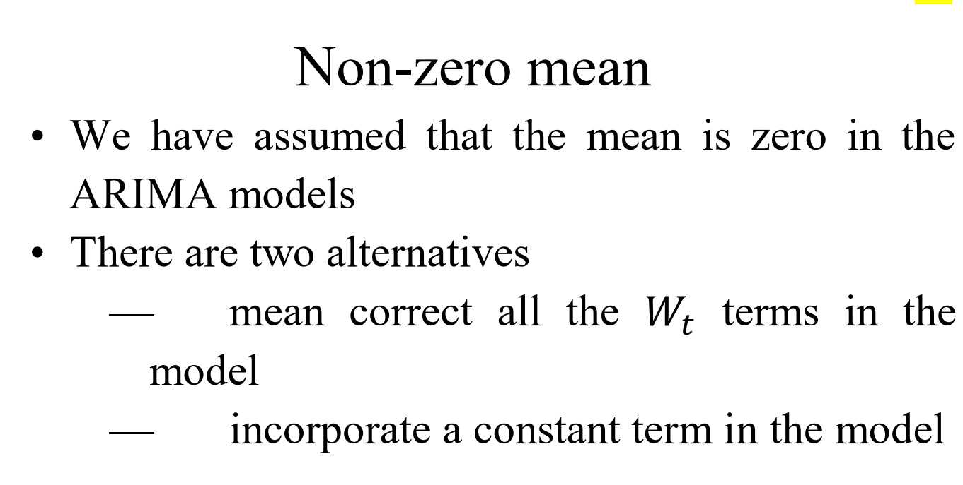

Slide 27
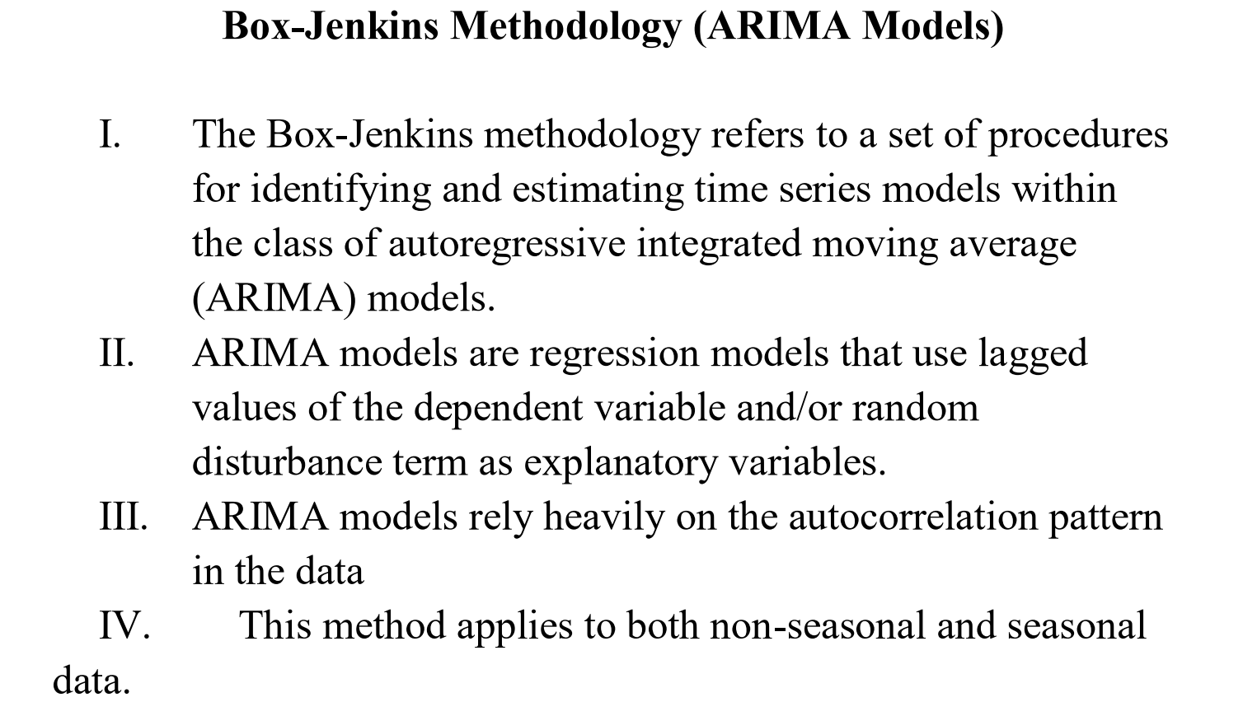
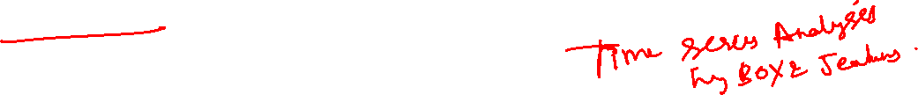

Slide 28
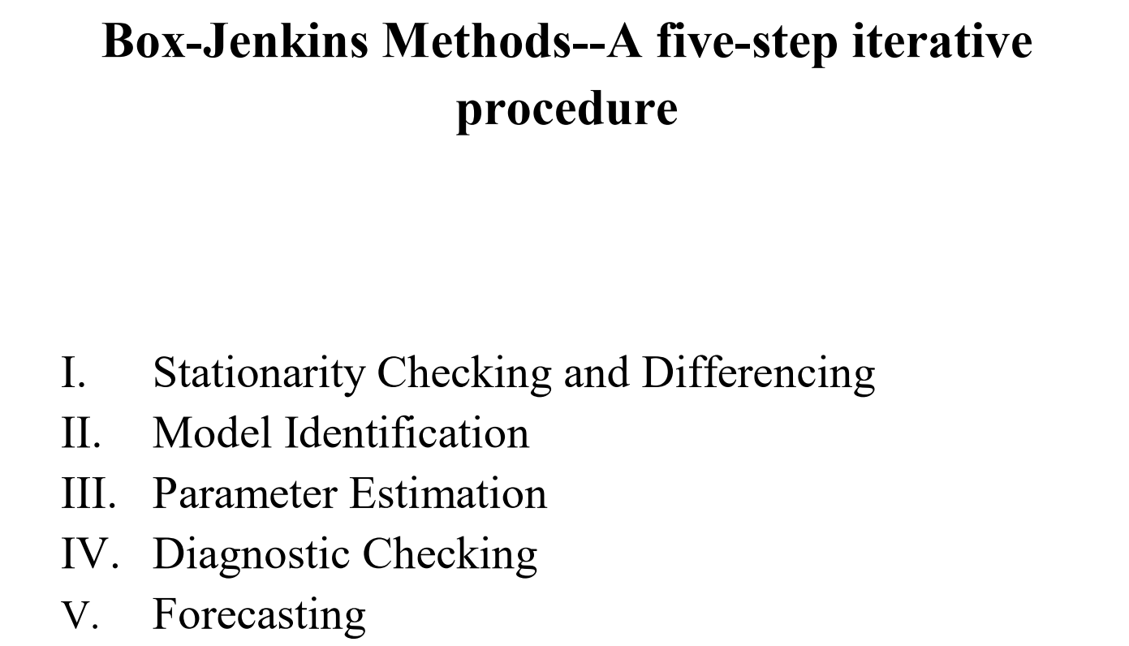
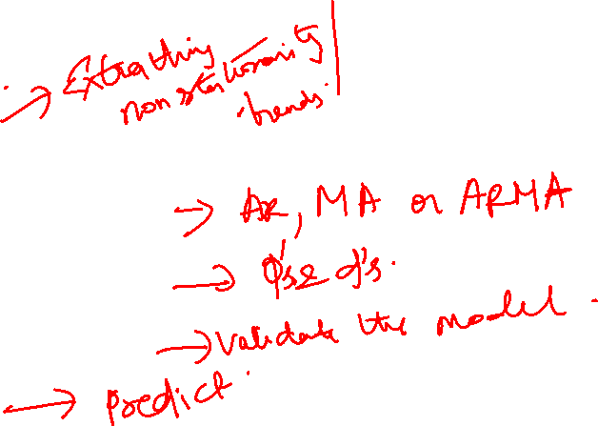

Slide 29
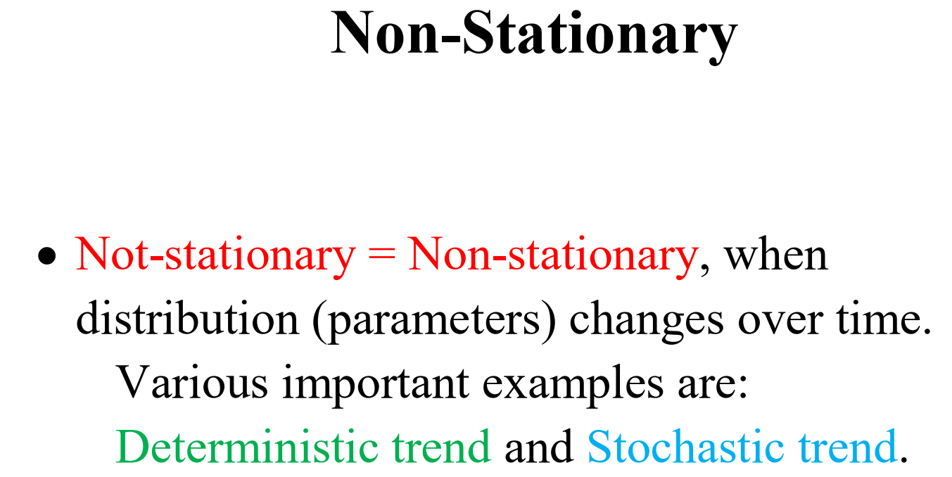

Slide 30
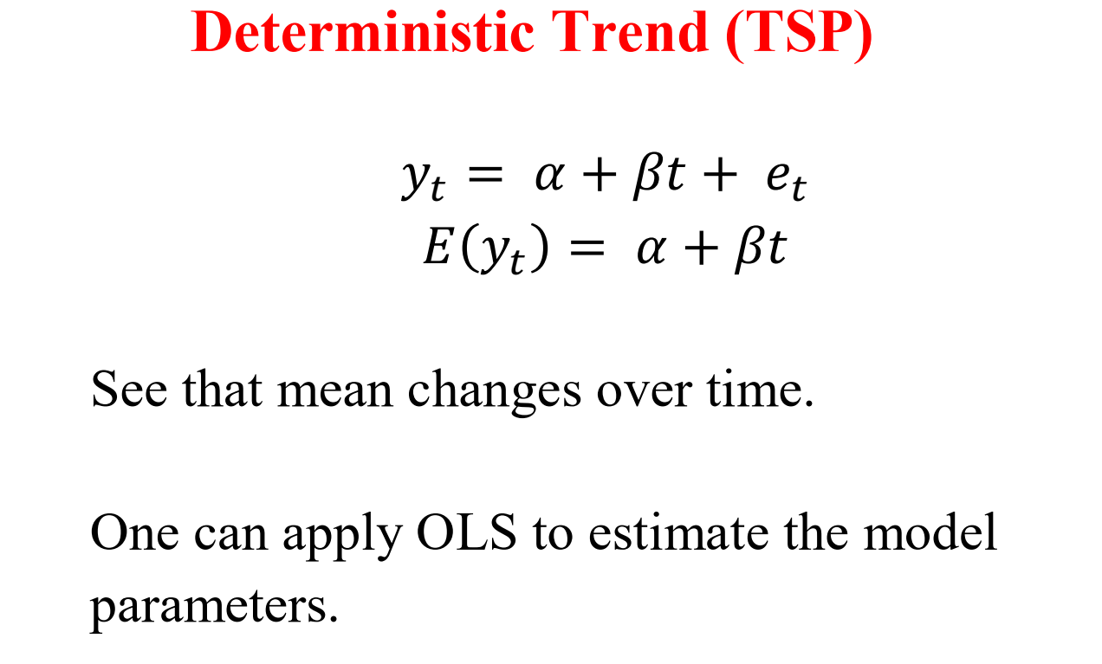
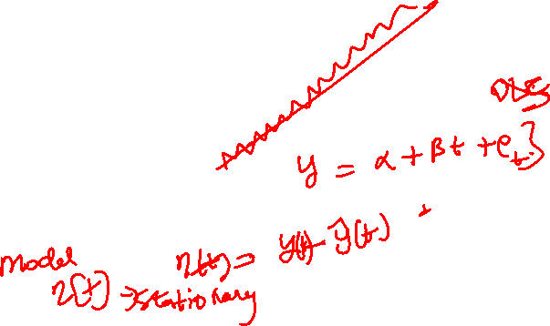

Slide 31
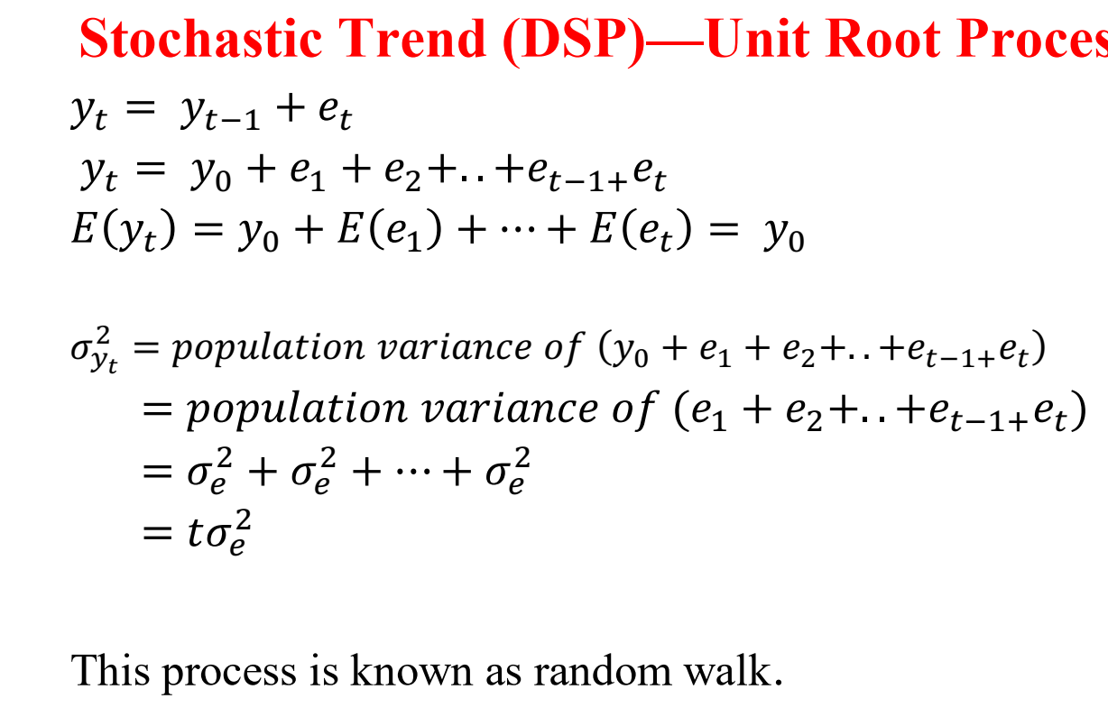

Slide 32
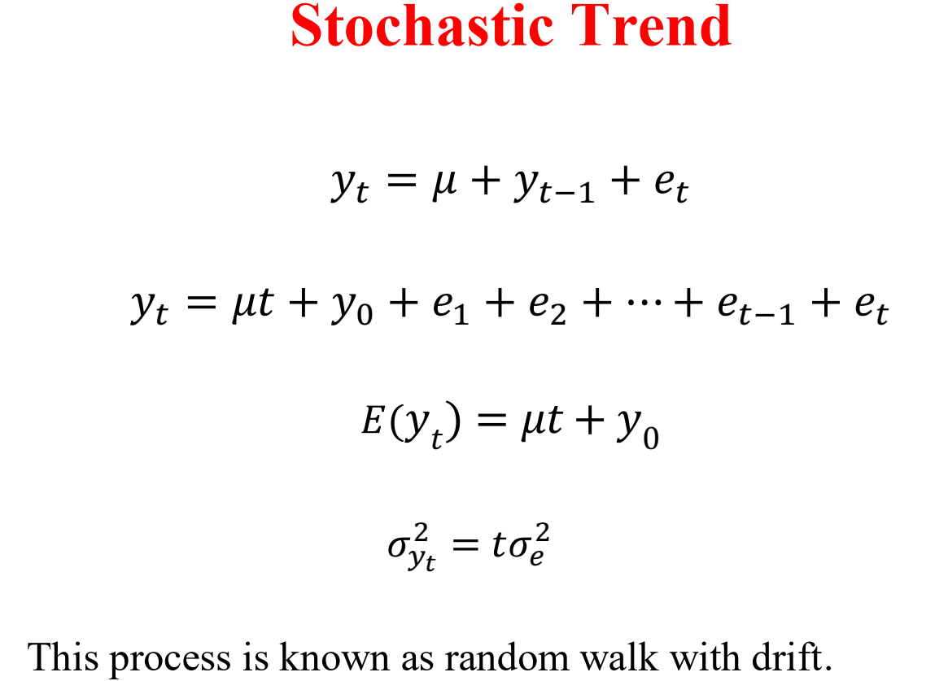

Slide 33
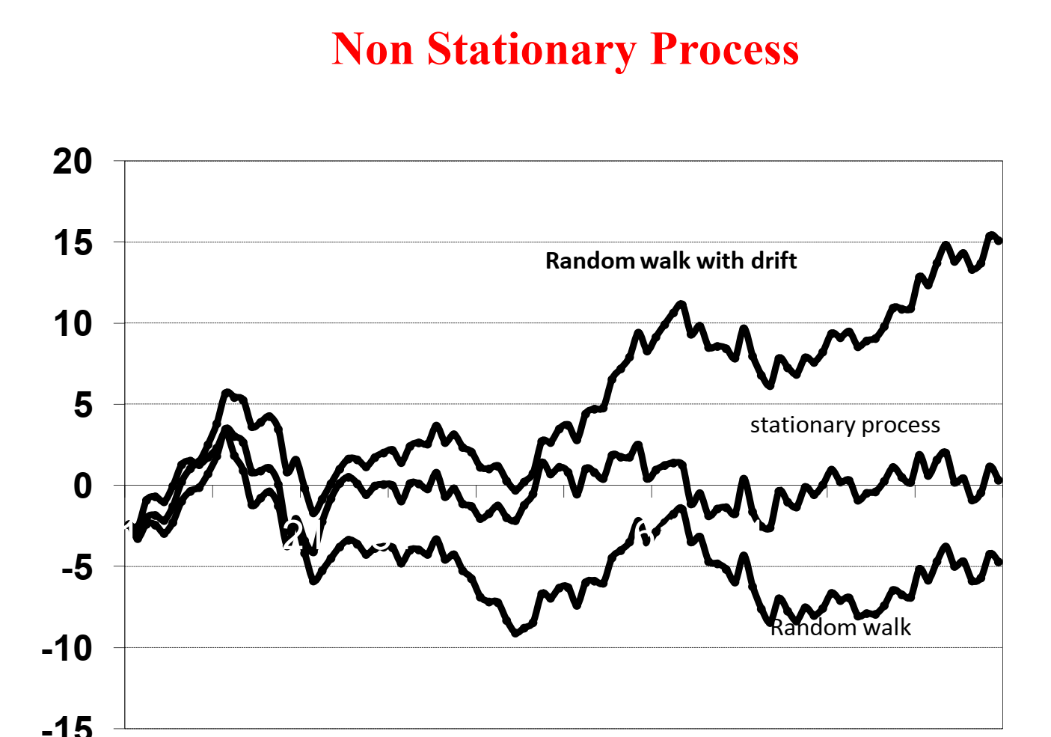
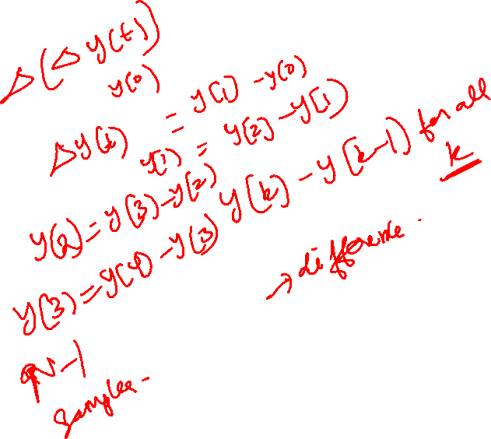

Slide 34
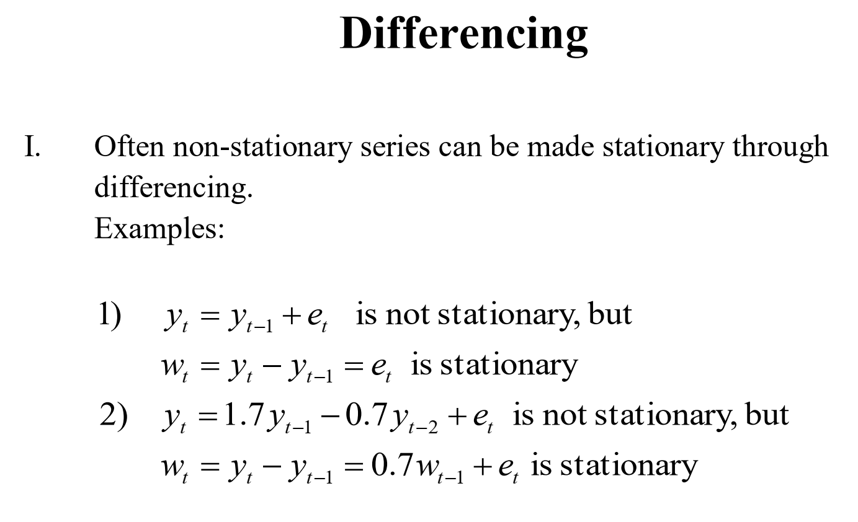
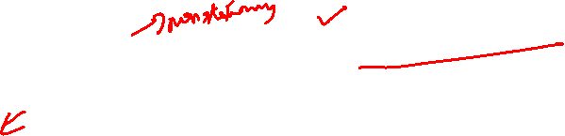

Slide 35
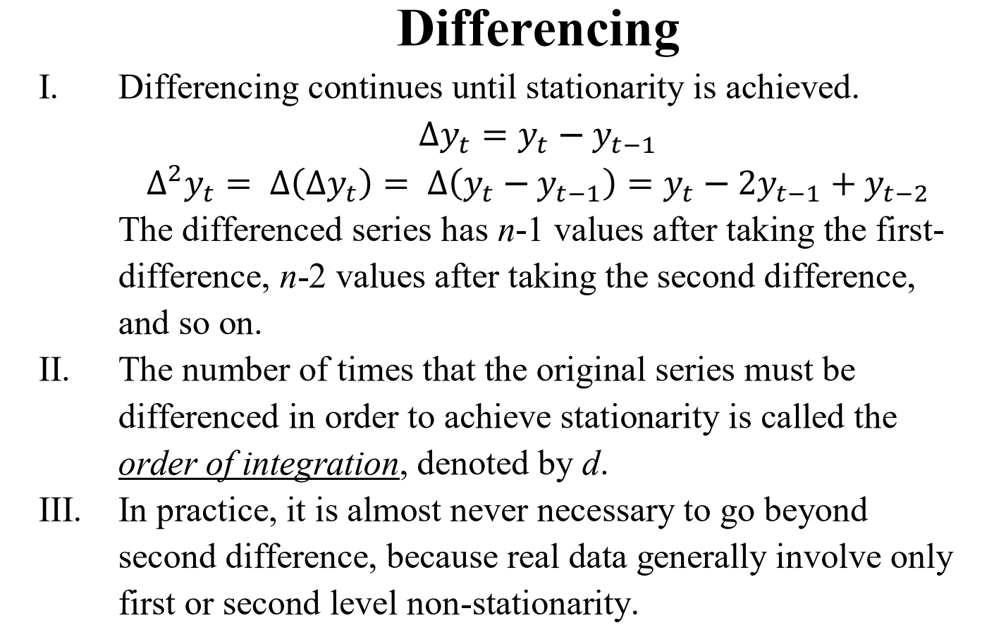

Slide 36
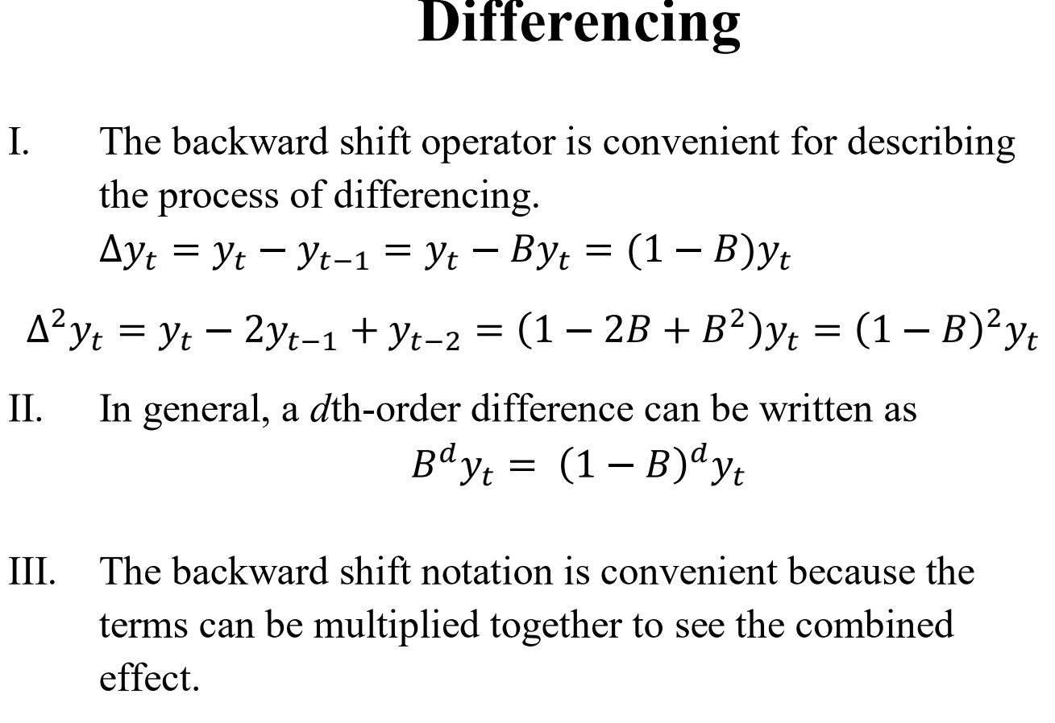

Slide 37
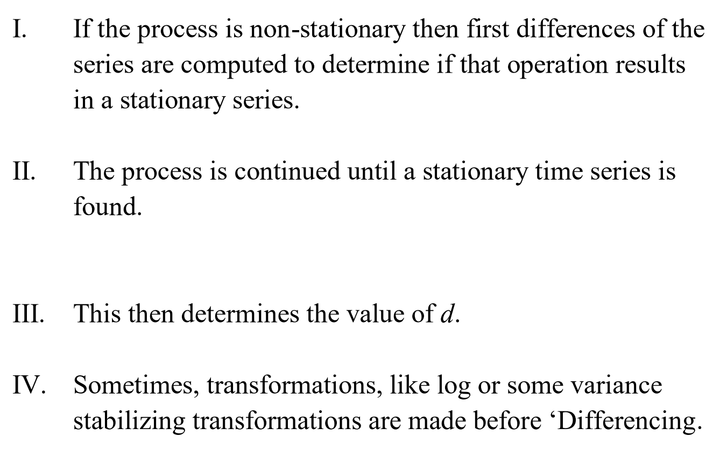

Slide 38

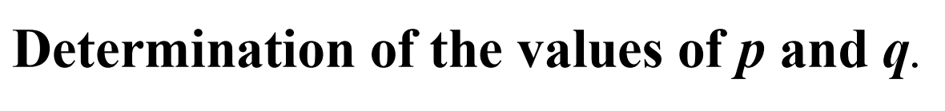

Slide 39
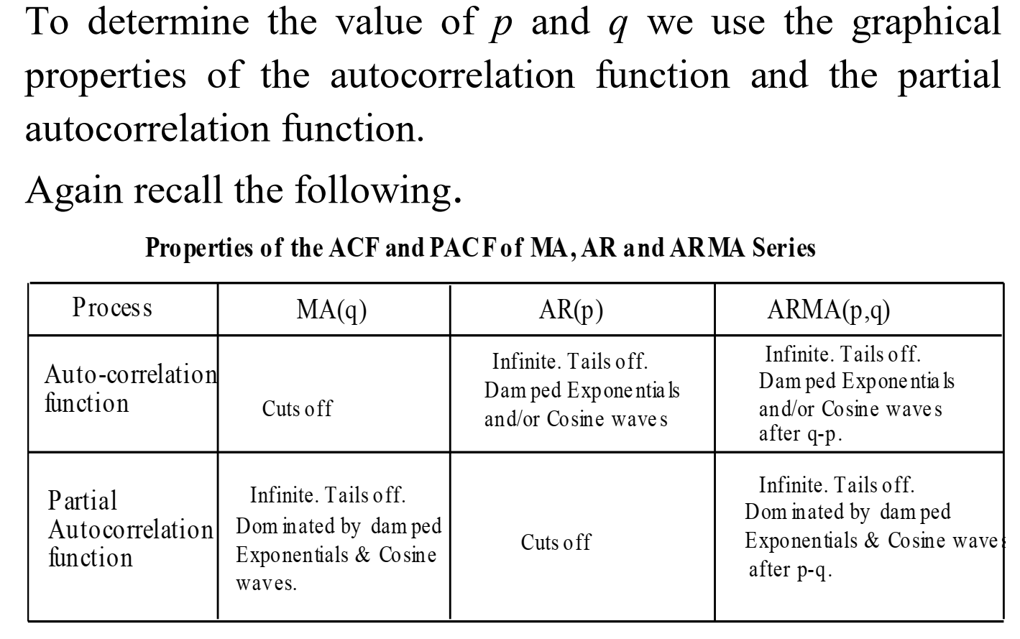

Slide 40



Slide 41


Slide 42


Slide 44



Slide 45



Slide 46



Slide 47



Slide 48



Slide 49


Slide 50


Slide 51


Slide 52


Slide 53


Slide 54


Slide 55


Slide 56


Slide 57


Slide 58


Slide 59


Slide 60


Slide 61


Slide 62



Slide 63


Slide 64



Slide 65


Slide 66



Slide 67


Slide 68


Slide 69


Slide 70



Slide 71


Slide 72



Slide 73


Slide 74



Slide 75


Slide 76


Slide 77



Slide 78


Slide 79


Slide 80


Slide 81


Slide 82


Slide 83


Slide 84


Slide 85


